Slide 1
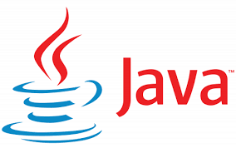
Course Name: Bachelor of Computer Applications
Course Code: 13010200
Subject: JAVA Programming Language
Unit - 1
Faculty Name:
Er. Arpit Chopra
Assistant Professor
School of Computer Science
Programme Name Semester- BCA-IV-Semester Subject- JAVA programming Language

Slide 2
Course Objectives
Understand fundamentals of programming such as variables, conditional and iterative execution, methods, etc.
Understand fundamentals of object-oriented programming in Java, including defining classes, invoking methods, using class libraries, etc.
Be aware of the important topics and principles of software development.
Have the ability to write a computer program to solve specified problems
Be able to use the Java SDK environment to create, debug and run simple Java programs.

Slide 3
Course | Course outcomes: - After completion of these courses students should be able to
13010200 Java Programming Language | CO 1:Define the features of Java Programming Language with Syntax and structure of Java Programs and how to use various operators in Java. CO 2:Explain how to implement the Object-oriented features by writing Java programs. CO3: Solve Arrays, Strings, Vectors, Packages etc. in Java and implementing the Exception handling Mechanism in Java. CO4: Analyze different concepts to create and use Threads and Packages in Java. CO5: Determine the different concepts of applets and adding them to a HTML File.

Slide 4
Mapping:
13010200 | PO1 | PO2 | PO3 | PO4 | PO5 | PO6 | PO7 | PO8 | PO9 | PO10 | PO11 | PO12
CO1 | 2 | 2 | 1 | - | 3 | - | 2 | - | 2 | 2 | - | 3
CO2 | 3 | - | 2 | 3 | - | 2 | - | 3 | 3 | - | 2 | 3
CO3 | 2 | 1 | 2 | 2 | 2 | 3 | 3 | 1 | 3 | 3 | 3 | 3
CO4 | 2 | 3 | 1 | - | 3 | - | 2 | 2 | 1 | 1 | - | 3
CO5 |  | 4 | 2 |  | 3 |  | 2 |  | 3 |  | 3

Slide 5

WHAT IS JAVA?
Java is one of the world's most important and widely used computer languages, and it has held this distinction for many years. Unlike some other computer languages whose influence has weared with passage of time, while Java's has grown.
Java is a high level, robust, object-oriented and a secure and stable programming language but it is not a pure object-oriented language because it supports primitive data types like int, char etc.
Java is a platform-independent language because it has runtime environment i.e. JRE and API. Here platform means a hardware or software environment in which an application runs.
Java codes are compiled into byte code or machine-independent code. This byte code is run on JVM (Java Virtual Machine).
The syntax is Java is almost the same as C/C++. But java does not support low-level programming functions like pointers. The codes in Java is always written in the form of Classes and objects.
As of 2020, Java is one of the most popular programming languages in use, especially for client-server web applications. Its has been estimated that there are around nine million Java developers inside the world.
Programme Name Semester- BCA-IV-Semester Subject- JAVA programming Language

Slide 6
Creation of Java
Java was developed by James Ghosling, Patrick Naughton, Mike Sheridan at Sun Microsystems Inc. in 1991. It took 18 months to develop the first working version.
The initial name was Oak but it was renamed to Java in 1995 as OAK was a registered trademark of another Tech company.
Application of Java
Java is widely used in every corner of world and of human life. Java is not only used in softwares but is also widely used in designing hardware controlling software components. There are more than 930 million JRE downloads each year and 3 billion mobile phones run java.
Following are some other usage of Java :
Developing Desktop Applications
Web Applications like Linkedin.com, Snapdeal.com etc
Mobile Operating System like Android
Embedded Systems
Robotics and games etc.
Programme Name Semester- BCA-IV-Semester Subject- JAVA programming Language

Slide 7
Types of Java Application
Following are different types of applications that we can develop using Java:
1. Standalone Applications
Standalone applications are the application which runs on separate computer process without adding any file processes. The standalone application is also known as Java GUI Applications or Desktop Applications which uses some standard GUI components such as AWT(Abstract Windowing Toolkit), swing and JavaFX and this component are deployed to the desktop. These components have buttons, menu, tables, GUI widget toolkit, 3D graphics etc. using this component a traditional software is developed which can be installed in every machine.
Example: Media player, antivirus, Paint, POS Billing software, etc.
2. Web Applications
Web Applications are the client-server software application which is run by the client. Servlets, struts, JSP, Spring, hibernate etc. are used for the development of a client-server application. eCommerce application is also developed in java using eCommerce platform i.e Broadleaf.
Example: mail, e-commerce website, bank website etc.
Programme Name Semester- BCA-IV-Semester Subject- JAVA programming Language

Slide 8
3. Enterprise Application
Enterprise application is middleware applications. To use software and hardware systems technologies and services across the enterprises. It is designed for the corporate area such as banking business systems.
Example: e-commerce, accounting, banking information systems etc.
4. Mobile Application
For mobile applications, Java uses ME or J2ME framework. This framework are the cross platform that runs applications across phones and smartphones. Java provides a platform for application development in Android too.
Example: WhatsApp, Xender etc.
Programme Name Semester- BCA-IV-Semester Subject- JAVA programming Language

Slide 9
Setting Java Environment and Classpath
An Environment variable is a dynamic "object" on a computer that stores a value(like a key-value pair), which can be referenced by one or more software programs in Windows. Like for Java, we will set an environment variable with name "java" and its value will be the path of the /bin directory present in Java directory. So whenever a program will require Java environment, it will look for the java environment variable which will give it the path to the execution directory.
Setting up path for windows
Assuming that you have installed Java in C:\ Program files/ Java / JDK directory
Step 1: Right click on my computer and select properties.
Step 2: Go to the Advance System Settings tab.
Step 3: Click on Environment Variables button.
Step 4: Now alter the path variable so that it also contains the path to JDK installed directory.
Programme Name Semester- BCA-IV-Semester Subject- JAVA programming Language

Slide 10
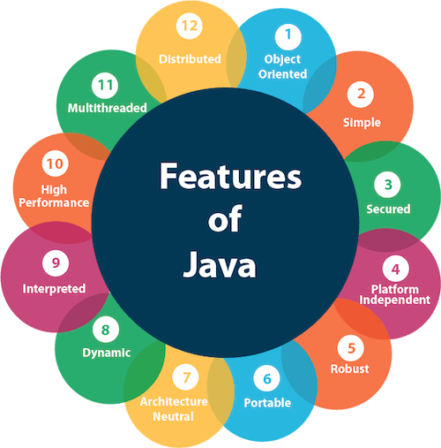
The features of Java are also known as Java buzzwords. A list of the most important features of the Java language is given below.
Simple
Object-Oriented
Portable
Platform independent
Secured
Robust
Architecture neutral
Interpreted
High Performance
Multithreaded
Distributed
Dynamic
Programme Name Semester- BCA-IV-Semester Subject- JAVA programming Language

Slide 11
Creating Hello World Example
class Simple{
public static void main(String args[]){
System.out.println("Hello Java");
}
}
Save the above file as Simple.java.
To compile:
javac Simple.java
To execute:
java Simple
Output:
Hello Java
Programme Name Semester- BCA-IV-Semester Subject- JAVA programming Language

Slide 12
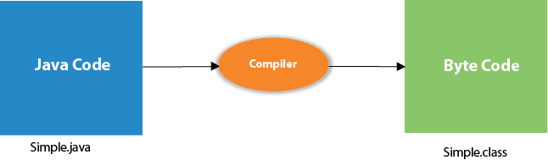
Compilation Flow:
When we compile Java program using javac tool, the Java compiler converts the source code into byte code.
Programme Name Semester- BCA-IV-Semester Subject- JAVA programming Language

Slide 13
Parameters used in First Java Program
Let's see what is the meaning of class, public, static, void, main, String[], System.out.println().
class keyword is used to declare a class in Java.
public keyword is an access modifier that represents visibility. It means it is visible to all.
static is a keyword. If we declare any method as static, it is known as the static method. The core advantage of the static method is that there is no need to create an object to invoke the static method.
The main() method is executed by the JVM, so it doesn't require creating an object to invoke the main() method. So, it saves memory.
void is the return type of the method. It means it doesn't return any value.
main represents the starting point of the program.
String[] args or String args[] is used for command line argument.
System.out.println() is used to print statement. Here, System is a class, out is an object of the PrintStream class, println() is a method of the PrintStream class.
Programme Name Semester- BCA-IV-Semester Subject- JAVA programming Language

Slide 14
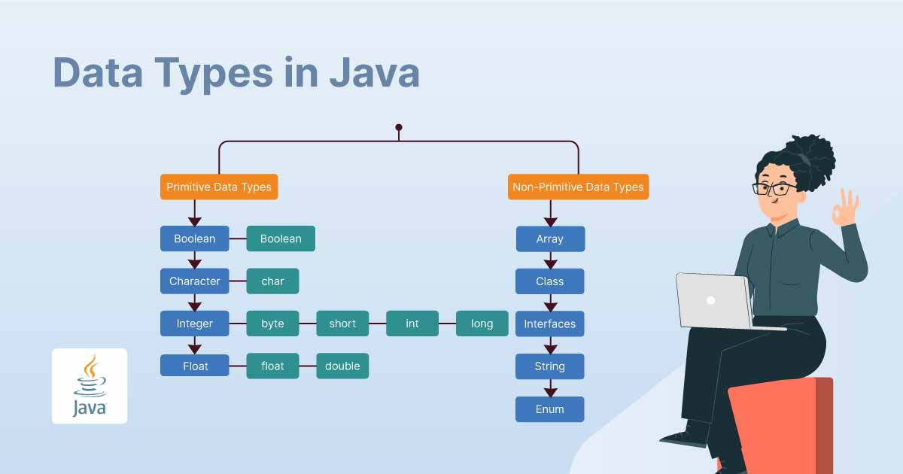
Data Types in Java
In Java, data types play a crucial role in defining the kind of information that can be stored and manipulated. Primitive data types, such as integers, floating-point numbers, characters, and booleans, provide the foundation for representing simple values. On the other hand, non-primitive data types, like arrays, classes, and interfaces, enable the creation of more complex structures and allow for the organization and manipulation of larger sets of data. Understanding and effectively utilizing these data types is essential for developing robust and efficient Java programs
Programme Name Semester- BCA-IV-Semester Subject- JAVA programming Language

Slide 15
A data type is a classification of data. It tells the compiler or interpreter how the programmer aims to use the variables or method. Data types are a crucial factor in all computer programming languages. The task of a programmer is to develop a workable program by assigning the right types of data to the right variables. Data types represent the type, nature, and set of operations for the value which they store. There are two data types of categories in Java: Primitive and Non-Primitive.
Data Type | Default value | Default Size | Range
byte | 0 | 1 byte or 8 bits | -128 to 127
short | 0 | 2 bytes or 16 bits | -32,768 to 32,767
int | 0 | 4 bytes or 32 bits | 2,147,483,648 to 2,147,483,647
long | 0 | 8 bytes or 64 bits | 9,223,372,036,854,775,808 to 9,223,372,036,854,775,807
float | 0.0f | 4 bytes or 32 bits | 1.4e-045 to 3.4e+038
double | 0.0d | 8 bytes or 64 bits | 4.9e-324 to 1.8e+308
char | ‘\u0000’ | 2 bytes or 16 bits | 0 to 65536
boolean | FALSE | 1 byte or 2 bytes | 0 or 1
Programme Name Semester- BCA-IV-Semester Subject- JAVA programming Language

Slide 16
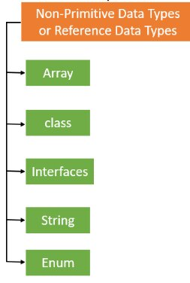
Non-Primitive Data Types
Non-primitive data types or reference data types refer to instances or objects. They cannot store the value of a variable directly in memory. They store a memory address of the variable. Unlike primitive data types we define by Java, non-primitive data types are user-defined. Programmers create them and can be assigned with null. All non-primitive data types are of equal size.
Programme Name Semester- BCA-IV-Semester Subject- JAVA programming Language

Slide 17
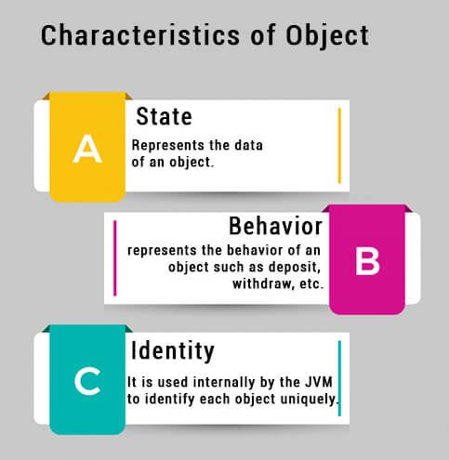
What is an object in Java
An entity that has state and behavior is known as an object e.g., chair, bike, marker, pen, table, car, etc. It can be physical or logical (tangible and intangible). The example of an intangible object is the banking system.
An object has three characteristics:
State: represents the data (value) of an object.
Behavior: represents the behavior (functionality) of an object such as deposit, withdraw, etc.
Identity: An object identity is typically implemented via a unique ID. The value of the ID is not visible to the external user. However, it is used internally by the JVM to identify each object uniquely.
An object is an instance of a class. A class is a template or blueprint from which objects are created. So, an object is the instance(result) of a class.
Object Definitions:
An object is a real-world entity.
An object is a runtime entity.
The object is an entity which has state and behavior.
The object is an instance of a class.
Programme Name Semester- BCA-IV-Semester Subject- JAVA programming Language

Slide 18
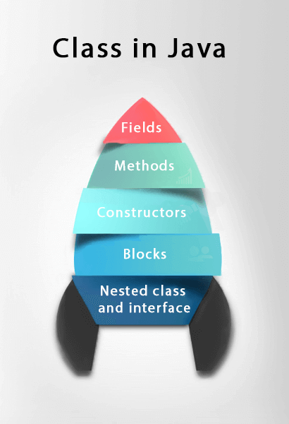
What is a class in Java
A class is a group of objects which have common properties. It is a template or blueprint from which objects are created. It is a logical entity. It can't be physical.
A class in Java can contain:
Fields
Methods
Constructors
Blocks
Nested class and interface
Syntax to declare a class:
class <class_name>{
field;
method;
}
Programme Name Semester- BCA-IV-Semester Subject- JAVA programming Language

Slide 19
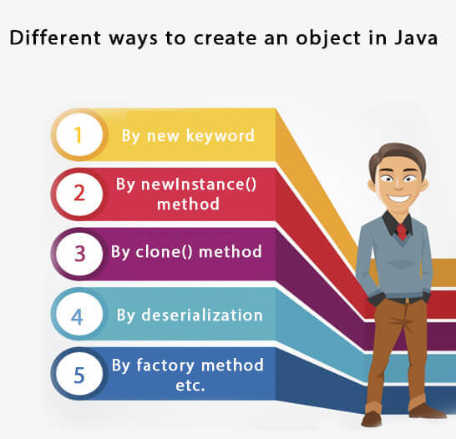
Programme Name Semester- BCA-IV-Semester Subject- JAVA programming Language

Slide 20
Constructors in Java
In Java, a constructor is a block of codes similar to the method. It is called when an instance of the class is created. At the time of calling constructor, memory for the object is allocated in the memory.
It is a special type of method which is used to initialize the object.
Every time an object is created using the new() keyword, at least one constructor is called.
It calls a default constructor if there is no constructor available in the class. In such case, Java compiler provides a default constructor by default.
There are two types of constructors in Java: no-arg constructor, and parameterized constructor.
Note: It is called constructor because it constructs the values at the time of object creation. It is not necessary to write a constructor for a class. It is because java compiler creates a default constructor if your class doesn't have any.
Rules for creating Java constructor
There are two rules defined for the constructor.
Constructor name must be the same as its class name
A Constructor must have no explicit return type
A Java constructor cannot be abstract, static, final, and synchronized
Programme Name Semester- BCA-IV-Semester Subject- JAVA programming Language

Slide 21
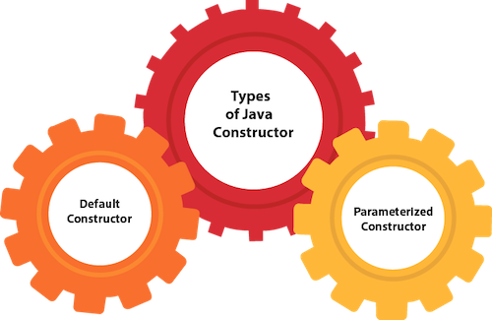
Types of Java constructors
There are two types of constructors in Java:
Default constructor (no-arg constructor)
Parameterized constructor
Programme Name Semester- BCA-IV-Semester Subject- JAVA programming Language

Slide 22
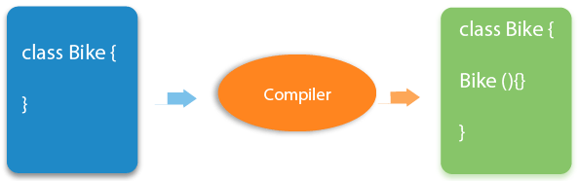
Java Default Constructor
A constructor is called "Default Constructor" when it doesn't have any parameter.
Syntax of default constructor:
<class_name>(){}
If there is no constructor in a class, compiler automatically creates a default constructor.
Programme Name Semester- BCA-IV-Semester Subject- JAVA programming Language

Slide 23
Java Parameterized Constructor
A constructor which has a specific number of parameters is called a parameterized constructor.
Why use the parameterized constructor?
The parameterized constructor is used to provide different values to distinct objects. However, you can provide the same values also.
Constructor Overloading in Java
In Java, a constructor is just like a method but without return type. It can also be overloaded like Java methods.
Constructor overloading in Java is a technique of having more than one constructor with different parameter lists. They are arranged in a way that each constructor performs a different task. They are differentiated by the compiler by the number of parameters in the list and their types.
Programme Name Semester- BCA-IV-Semester Subject- JAVA programming Language

Slide 24
Difference between constructor and method in Java
There are many differences between constructors and methods. They are given below.
Java Constructor | Java Methods
A constructor is used to initialize the state of an object. | A method is used to expose the behavior of an object.
A constructor must not have a return type. | A method must have a return type.
The constructor is invoked implicitly. | The method is invoked explicitly.
The Java compiler provides a default constructor if you don't have any constructor in a class. | The method is not provided by the compiler in any case.
The constructor name must be same as the class name. | The method name may or may not be same as the class name.
Programme Name Semester- BCA-IV-Semester Subject- JAVA programming Language

Slide 25
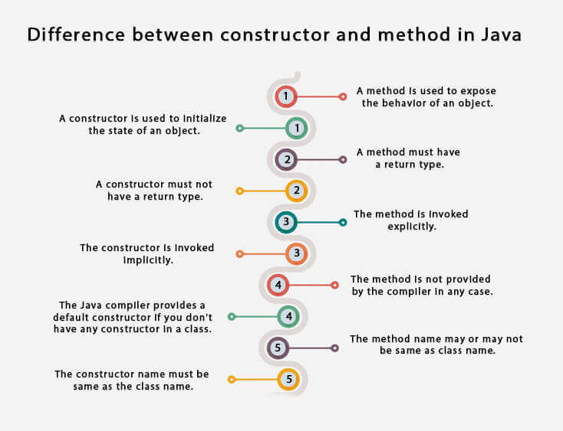
Programme Name Semester- BCA-IV-Semester Subject- JAVA programming Language

Slide 26
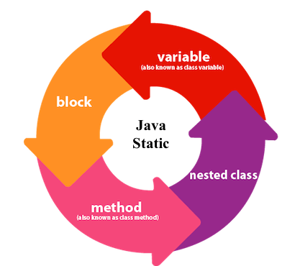
Java static keyword
The static keyword in Java is used for memory management mainly. We can apply static keyword with variables, methods, blocks and nested classes. The static keyword belongs to the class than an instance of the class.
The static can be:
Variable (also known as a class variable)
Method (also known as a class method)
Block
Nested class
1) Java static variable
If you declare any variable as static, it is known as a static variable.
The static variable can be used to refer to the common property of all objects (which is not unique for each object), for example, the company name of employees, college name of students, etc.
The static variable gets memory only once in the class area at the time of class loading.
Programme Name Semester- BCA-IV-Semester Subject- JAVA programming Language

Slide 27

2) Java static method
If you apply static keyword with any method, it is known as static method.
A static method belongs to the class rather than the object of a class.
A static method can be invoked without the need for creating an instance of a class.
A static method can access static data member and can change the value of it.
3) Java static block
Is used to initialize the static data member.
It is executed before the main method at the time of classloading.
Programme Name Semester- BCA-IV-Semester Subject- JAVA programming Language

Slide 28
Inheritance in Java
Inheritance in Java is a mechanism in which one object acquires all the properties and behaviors of a parent object. It is an important part of OOPs (Object Oriented programming system).
The idea behind inheritance in Java is that you can create new classes that are built upon existing classes. When you inherit from an existing class, you can reuse methods and fields of the parent class. Moreover, you can add new methods and fields in your current class also.
Inheritance represents the IS-A relationship which is also known as a parent-child relationship.
Why use inheritance in java
For Method Overriding (so runtime polymorphism can be achieved).
For Code Reusability.
Terms used in Inheritance
Class: A class is a group of objects which have common properties. It is a template or blueprint from which objects are created.
Sub Class/Child Class: Subclass is a class which inherits the other class. It is also called a derived class, extended class, or child class.
Super Class/Parent Class: Superclass is the class from where a subclass inherits the features. It is also called a base class or a parent class.
Reusability: As the name specifies, reusability is a mechanism which facilitates you to reuse the fields and methods of the existing class when you create a new class. You can use the same fields and methods already defined in the previous class.
Programme Name Semester- BCA-IV-Semester Subject- JAVA programming Language

Slide 29
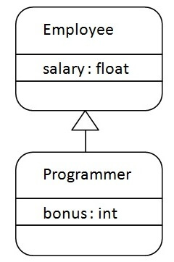
The syntax of Java Inheritance
class Subclass-name extends Superclass-name
{
//methods and fields
}
The extends keyword indicates that you are making a new class that derives from an existing class. The meaning of "extends" is to increase the functionality.
Programme Name Semester- BCA-IV-Semester Subject- JAVA programming Language

Slide 30
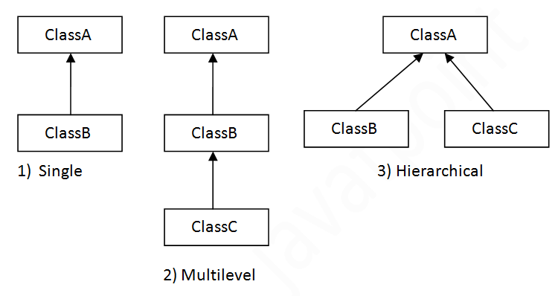
Types of inheritance in java
Programme Name Semester- BCA-IV-Semester Subject- JAVA programming Language

Slide 31
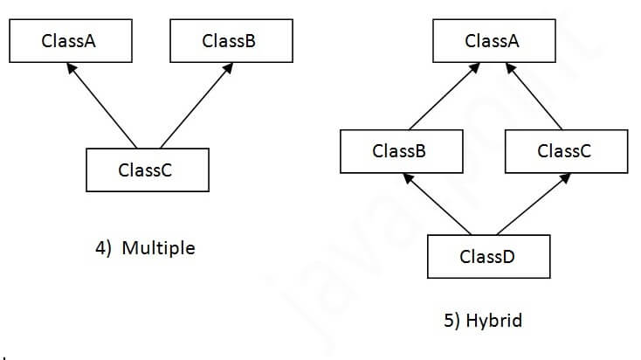
Multiple inheritance is not supported in Java through class.
Programme Name Semester- BCA-IV-Semester Subject- JAVA programming Language

Slide 32

Programme Name Semester- BCA-IV-Semester Subject- JAVA programming Language

